Slide 1

Binary Image Model Classifiers
Binary Image Model Classifiers
SHOULD THEY BE USED?

Slide 2

A binary image classifier is a type of machine learning model that classifies images into one of two possible categories, or "binary" classes. The model is trained to take an image as input and determine whether it belongs to Class A or Class B. Or in this case dirty or clean.
The future of image model classifiers holds immense potential to transform industries, enhance efficiency, improve safety, and provide personalized experiences across various domains. As the technology continues to evolve, we can expect more sophisticated models with broader applications, benefiting everything from daily life to cutting-edge scientific research.

Slide 3
1. Healthcare and Medical Imaging
Faster Diagnoses: Image classifiers can analyze medical images (like X-rays, MRIs, and CT scans) more quickly than humans, helping doctors make faster diagnoses.
Improved Accuracy: Advanced models can help detect subtle anomalies or early signs of diseases (e.g., cancer) that might be missed by human eyes.
Personalized Medicine: Image classifiers could assist in tailoring treatments to individuals by analyzing their medical imaging data and predicting outcomes.
2. Autonomous Vehicles
Improved Object Recognition: Future image classifiers will help autonomous vehicles better understand and interpret their surroundings, improving safety and navigation.
Enhanced Decision-Making: Advanced models will allow cars to make faster and more accurate decisions in real-time, such as identifying pedestrians, vehicles, road signs, and obstacles.
Accident Prevention: By continuously improving image classification models, autonomous vehicles can anticipate and avoid dangerous situations more effectively.
3. Security and Surveillance
Anomaly Detection: Image classifiers will enhance surveillance systems by automatically identifying unusual behavior, unauthorized access, or suspicious objects in real-time.
Facial Recognition: As classifiers improve, facial recognition systems will become more reliable and secure, helping in law enforcement and other security applications.
Real-Time Threat Detection: Future classifiers can process security footage and detect threats, potentially preventing crimes or identifying individuals of interest faster.
4. Agriculture and Environmental Monitoring
Crop Health Monitoring: Image classifiers can be used to monitor crop health, detect diseases, or identify nutrient deficiencies, enabling precision agriculture and better crop management.
Wildlife and Conservation: Automated systems can classify species from camera trap images, helping researchers study wildlife populations and biodiversity without manual identification.
Environmental Monitoring: Image models can be used for satellite and drone imagery analysis, helping to track deforestation, land use, and climate change impacts over time.
5. Manufacturing and Quality Control
Automated Quality Inspection: Future classifiers will be able to detect defects in products or machinery, ensuring higher quality standards and reducing the need for human inspection.
Predictive Maintenance: By analyzing images of equipment, classifiers can predict when a machine is likely to fail, allowing companies to perform maintenance before problems arise.
6. Augmented Reality (AR) and Virtual Reality (VR)
Real-Time Object Identification: In AR, image classifiers will enable real-time object recognition, improving the interaction between the physical and digital worlds.

Slide 4



Enhanced User Experiences: Image classification in VR environments can create more immersive and interactive experiences, such as recognizing gestures or detecting objects in the virtual space.
7. E-Commerce and Retail
Visual Search: Image classifiers will enable better visual search capabilities, allowing users to search for products by uploading images rather than typing keywords.
Automated Inventory Management: In retail, classifiers can help track inventory levels by analyzing images of stock shelves, ensuring that shelves are always well-stocked.
Personalized Recommendations: Future image classifiers can analyze customer behavior through images (e.g., uploaded photos) and suggest personalized products based on visual preferences.
8. Accessibility and Assistive Technologies
Aid for the Visually Impaired: Image classifiers can be integrated into assistive technologies, such as smart glasses, to help visually impaired individuals understand their surroundings by describing objects, faces, and scenes in real-time.
Improved Human-Computer Interaction: Classifiers can recognize gestures, facial expressions, or objects, allowing for more intuitive and accessible user interfaces.
9. Art and Cultural Preservation
Art Restoration: Image classification models can analyze art and artifacts, detecting patterns of wear or damage that need restoration.
Cultural Heritage Digitization: Image models can help preserve cultural heritage by classifying and organizing vast archives of historical photographs, manuscripts, and artifacts.
10. Robotics
Enhanced Vision Systems: In robotics, image classifiers will improve object detection and recognition, allowing robots to perform complex tasks like picking and sorting items, autonomous navigation, and interacting with environments more naturally.
Human-Robot Interaction: Classifiers will enable robots to better understand and respond to human actions, gestures, and emotions, making them more effective in collaborative settings.
11. Social Media and Content Moderation
Automatic Content Filtering: Image classifiers can help social media platforms automatically detect and remove inappropriate content, such as violence, hate speech, or adult content.
Enhanced User Experience: Image classifiers will enable features like automatic photo tagging, image search, and more personalized feeds.
12. Education and Training
Automated Grading: Classifiers can assist in automated grading of image-based assignments, such as art, diagrams, or technical drawings.
Interactive Learning Tools: Future image classification models could help build more interactive and engaging learning environments, enabling personalized content delivery based on a student's visual input.

Slide 5
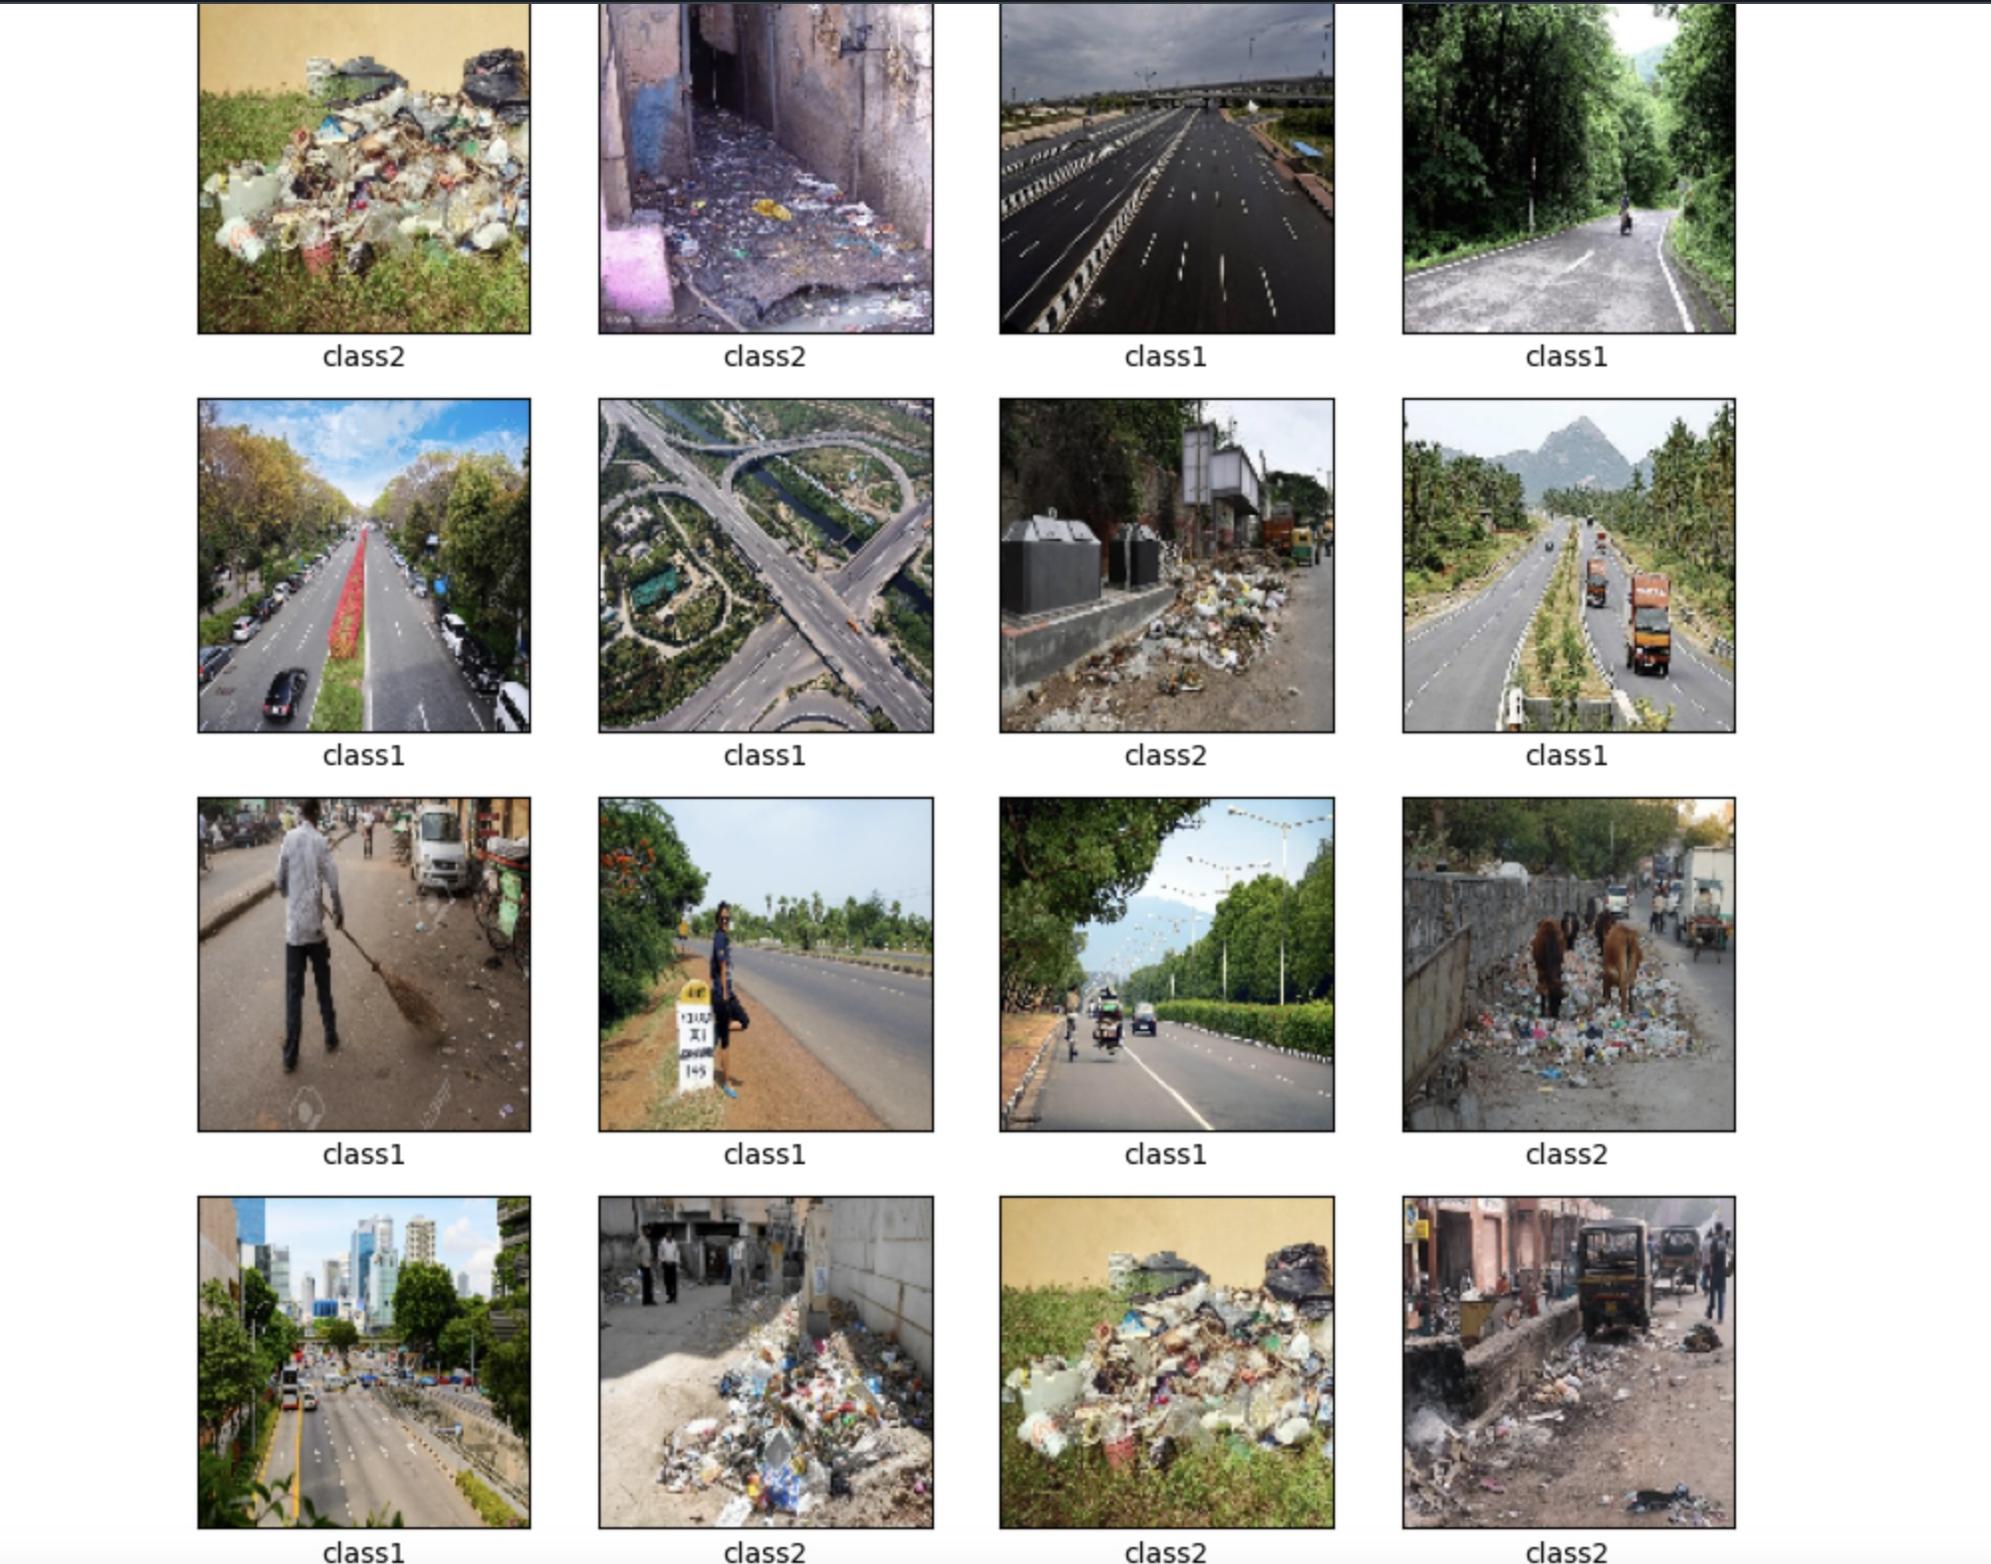

Slide 6

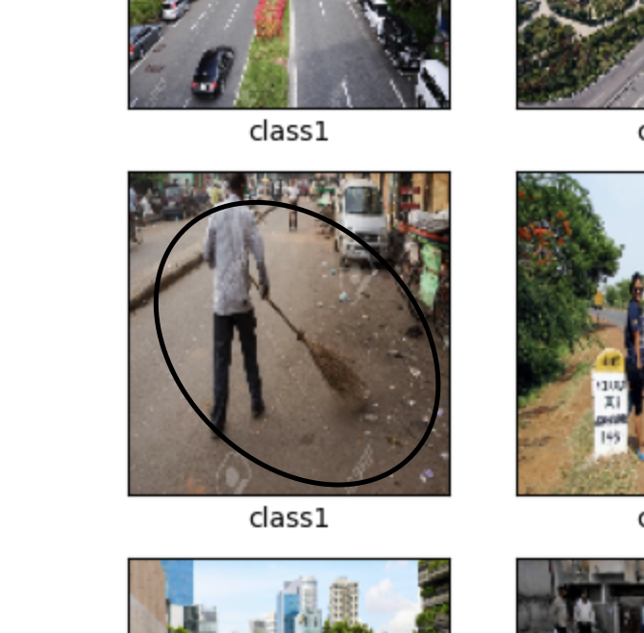
In summary the concerning aspect here is the model’s reasoning is based on superficial associations between human activity and cleanliness. This image was incorrectly classified as clean because the model recognized the action of sweeping, failing to understand that the street was still dirty. This error exposes a fundamental limitation of machine learning models: they often lack the ability to truly understand the context or process behind an image, leading to misclassifications based on incomplete or misleading visual cues.

Slide 7
